Slide 1
Data Structures & Algorithms (CSC-214)
Lecture 21: Hash Tables – Open Addressing

Slide 2
Hash tables: handling collisions with chaining

Slide 3
#include <list>
#include <iostream>
using namespace std;
class HashArray {
private:
static const int arraySize = 10;
list<int> data[arraySize];
int hashFunction(int key) {
return (key/10 + key%10) % arraySize;
}
public:
HashArray() {
for (int i = 0; i < arraySize; ++i) {
data[i] = list<int>();
}
}
void insert(int value) {
int index = hashFunction(value);
data[index].push_back(value);
}
void display() {
for (int i = 0; i < arraySize; ++i) {
cout << "Index " << i << ": ";
if (!data[i].empty()) {
// this loop executes a cout statement
// for each value in data[i]
for (int val : data[i]) {
cout << val << " -> ";
}
}
else {
cout << "Empty";
}
cout << endl;
}
}
};
int main() {
HashArray hashArray;
hashArray.insert(15);
hashArray.insert(25);
hashArray.insert(35);
hashArray.insert(45);
hashArray.insert(55);
hashArray.insert(18);
hashArray.display();
return 0;
}

Slide 4
int hashFunction(int key) {
return (key/10 + key%10) % arraySize;
}
int main() {
HashArray hashArray;
hashArray.insert(15);
hashArray.insert(25);
hashArray.inseart(35);
hashArray.insert(45);
hashArray.insert(55);
hashArray.insert(18);
hashArray.display();
return 0;
}
Show the hash table structure

Slide 5
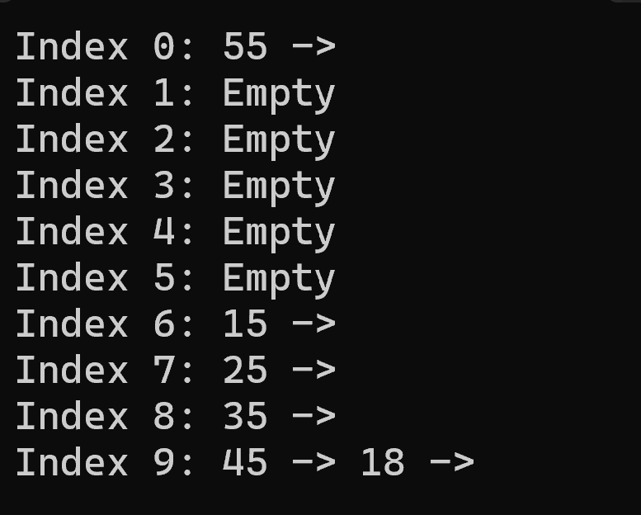
int hashFunction(int key) {
return (key/10 + key%10) % arraySize;
}
int main() {
HashArray hashArray;
hashArray.insert(15);
hashArray.insert(25);
hashArray.inseart(35);
hashArray.insert(45);
hashArray.insert(55);
hashArray.insert(18);
hashArray.display();
return 0;
}

Slide 6
Hash tables: handling collisions with open addressing

Slide 7
Open Addressing
Open Addressing is a method for handling collisions
In Open Addressing, all elements are stored in the hash table itself
So at any point, the size of the table must be greater than or equal to the total number of keys

Slide 8
Open Addressing Types
Linear probing
In linear probing, the hash table is searched sequentially that starts from the original location of the hash. If in case the location that we get is already occupied, then we check for the next location.
And others (that we won’t be covering)

Slide 9
class HashArray {
private:
static const int arraySize = 10;
int data[arraySize];
int hashFunction(int key) {
return key % arraySize;
}
public:
HashArray() {
for (int i = 0; i < arraySize; ++i) {
data[i] = -1; }
}
void insert(int value) {
int index = hashFunction(value);
while (data[index] != -1) {
index = (index + 1) % arraySize;
}
data[index] = value;
}
void display() {
for (int i = 0; i < arraySize; ++i) {
cout << "Index " << i << ": ";
if (data[i] != -1) {
cout << data[i];
}
else {
cout << "Empty";
}
cout << endl;
}
}
};
int main() {
HashArray hashArray;
hashArray.insert(15);
hashArray.insert(25);
hashArray.insert(35);
hashArray.insert(45);
hashArray.insert(55);
hashArray.display();
return 0;
}

Slide 10
class HashArray {
private:
static const int arraySize = 10;
int data[arraySize];
int hashFunction(int key) {
return key % arraySize;
}
public:
HashArray() {
for (int i = 0; i < arraySize; ++i) {
data[i] = -1; }
}
void insert(int value) {
int index = hashFunction(value);
while (data[index] != -1) {
index = (index + 1) % arraySize;
}
data[index] = value;
}
};
int main() {
HashArray hashArray;
hashArray.insert(15);
hashArray.insert(25);
hashArray.insert(35);
hashArray.insert(45);
hashArray.insert(55);
hashArray.display();
return 0;
}
Show the hash table structure.

Slide 11
class HashArray {
private:
static const int arraySize = 10;
int data[arraySize];
int hashFunction(int key) {
return key % arraySize;
}
public:
HashArray() {
for (int i = 0; i < arraySize; ++i) {
data[i] = -1; }
}
void insert(int value) {
int index = hashFunction(value);
while (data[index] != -1) {
index = (index + 1) % arraySize;
}
data[index] = value;
}
};
Index 0: Empty
Index 1: Empty
Index 2: Empty
Index 3: Empty
Index 4: Empty
Index 5: 15
Index 6: 25
Index 7: 35
Index 8: 45
Index 9: 55
int main() {
HashArray hashArray;
hashArray.insert(15);
hashArray.insert(25);
hashArray.insert(35);
hashArray.insert(45);
hashArray.insert(55);
hashArray.display();
return 0;
}

Slide 12
Deleting from a hash table
Not easy in open addressing. Deleting from chaining is easier
Compute the index of the input value, if found, replace the value with a sentinel value eg -100.
This sentinel value should be different from the sentinel value used to denote an empty slot eg -1
Will help in searching the hash table up until we reach -1

Slide 13
Searching hash table:
Find input at the computed index
If found, return true
If not found, keep searching the adjacent slots
Keep searching until an empty slot is found
Important: Sentinel value for empty and deleted slots should be different.
Searching should not stop if we come across a deleted slot

Slide 14
Complexity
Chaining: O(1)
Open addressing:
Search: O(n) as we end up sequentially searching

Slide 15
Practically possible to dynamically allocate more memory (allocate more, copy old values, release earlier memory, continue)

